Slide 1
Empathic Listening
Mossammad Salma Sultana

Slide 2
Overview
What is empathic listening?
Key Components of Empathic Listening
The Outcomes of Empathic Listening in any Communication
The 5 Steps of Empathic Listening Skill
Understanding Empathic Listening through Examples
Conclusion

Slide 3

What is empathic listening?
Empathic listening is a communication technique that involves listening to another person with the intent to understand their thoughts, feelings, and perspective. It goes beyond simply hearing the words being spoken; it requires a deeper connection and engagement with the speaker.

Slide 4
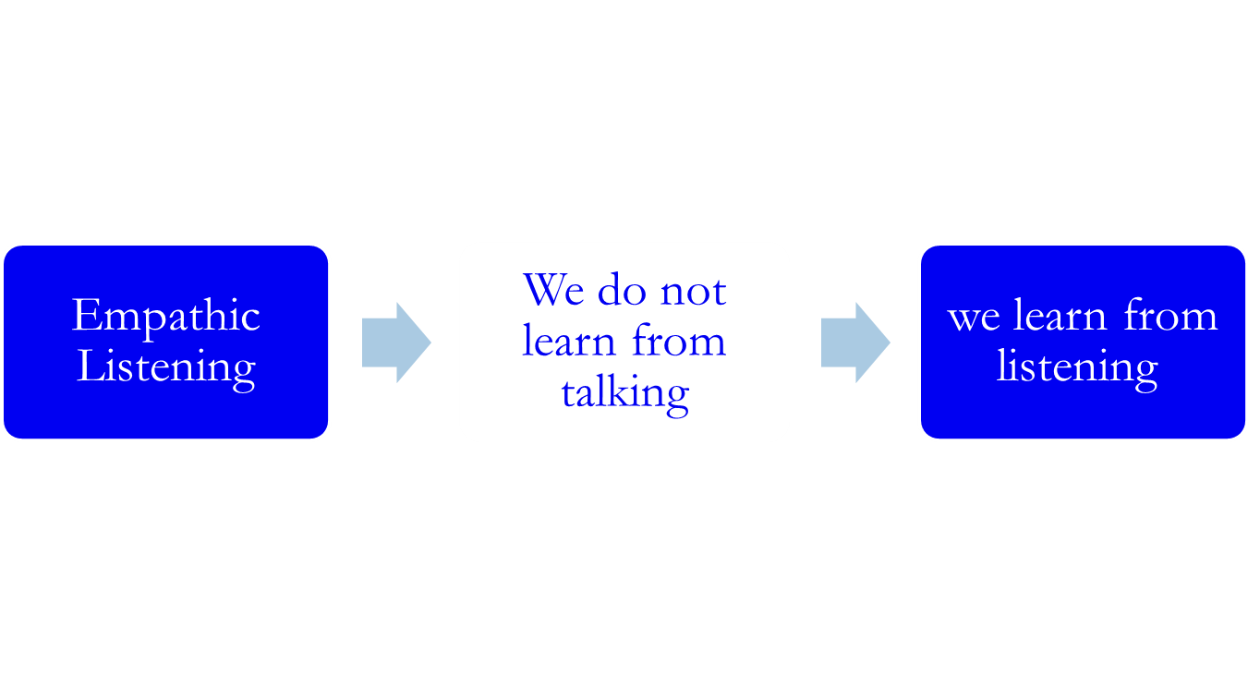
Understanding Empathic Listening

Slide 5
Key Components of Empathic Listening
1. Full Attention | Giving the speaker undivided attention, free from distractions
2. Non-Verbal Expression | Using body language, such as nodding and maintaining eye contact
3. Reflecting & Paraphrasing | Repeating back what the speaker has said in own words to confirm understanding
4. Empathy | Demonstrating understanding and compassion for the speaker's feelings and experiences.
5.Appropriate Responses | Responding in a way that acknowledges the speaker’s emotions and provides support or feedback as needed.

Slide 6

The Outcomes of Empathic Listening in any Communication
Helps build trust
Strengthen relationships
Improve communication by making the speaker feel heard, understood, and valued

Slide 7
The 5 Steps of Empathic Listening Skill
1) To quiet mind and focus on the other person as they are speaking
2) To listen fully and openly to what they are saying
3)To listen "through the words" to the deeper thoughts and feelings sensed from the speaker
4) To refrain from interrupting the speaker when they are speaking
5) To repeat back to them, in own words, what the speaker said and the feelings sensed from them to ensure accurate understanding and to make them feel understood.

Slide 8
Example-1 of repeating back to the speaker
Speaker | Listener
Speaker with a down expression on their face and in their voice: "Our dog died yesterday. We had her for 15 years. She was a wonderful dog, a member of our family.” | Listener with a similar somber tone and facial expression: "You really miss her."
"Yeah, she was the best."
Result: The speaker feels the listener senses their pain.

Slide 9
Example-2 of repeating back to the speaker
Speaker | Listener
Speaker with enthusiasm: "We had the best time ever in the mountains-clear blue skies, beautiful scenery, fresh air-I loved it!" | Listener smiling: "Wow, sounds like you had an absolutely wonderful time!”
"We sure did!"
Result: The speaker feels the listener is resonating with their joy.

Slide 10
Example-3 of repeating back to the speaker
Speaker | Listener
Speaker appearing frustrated: "My job is really rough right now-so many tasks to do and so little time to get them done." | Listener with a look of concern: "You feel totally overwhelmed with all you have to do."
"Yeah, I feel swamped."
Result: The speaker feels the listenteer understands how overburdened and stressed out they are. As the listener, notice that your responses simply indicate that you empathically heard and felt what the speaker was communicating. You're not fixing anything,

Slide 11
Conclusion
Empathic listening is more than just hearing words. It's about understanding the emotions and intentions behind those words. It's about connecting with the speaker on a deeper level.
Empathic listening can transform our interactions, making our classrooms and work environments more supportive and understanding.
So let's practice listening with empathy every day. in personal relationships, educational settings, and professional environments where effective communication is essential.

Slide 12
Thank You

